Slide 1

Digital Library Management
Join us on a journey to explore the world of digital library management. Discover the purpose, scope, technologies, and features of an innovative system.
Submitted by:
Sabyasachi Ghosh(2129093)
Sakshi Maurya(2129096)
V.Shashank(2129120)

Slide 2


Introduction
Welcome to the Digital Library Management presentation! This page will provide you with an overview of the key aspects and functionalities of a modern digital library system.
Learn about the purpose behind the development of a digital library management system, including its benefits and how it enhances the accessibility and organization of information.

Slide 3
Technologies
HTML
JS
Create the structure and content of web pages using the standard markup language for the web.
Implement interactivity and dynamic functionality with JavaScript, the programming language of the web.
CSS
PHP
Make your digital library visually appealing and user-friendly with cascading style sheets.
Build server-side logic and connect with databases using PHP, a popular backend programming language.
SQL
SQL queries and other operations take the form of commands written as statements and are aggregated into programs that enable users to add, modify or retrieve data from database tables.

Slide 4
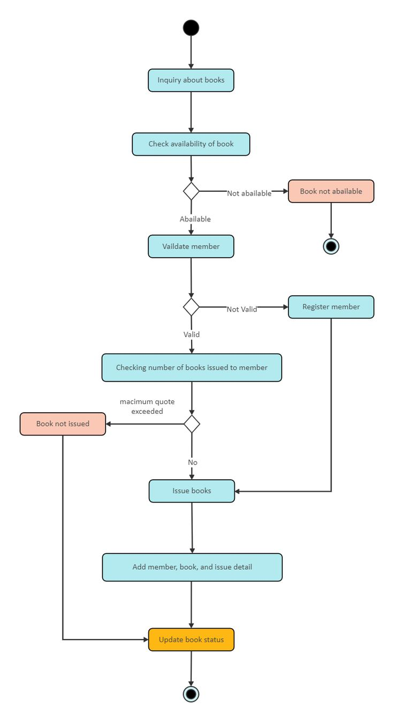
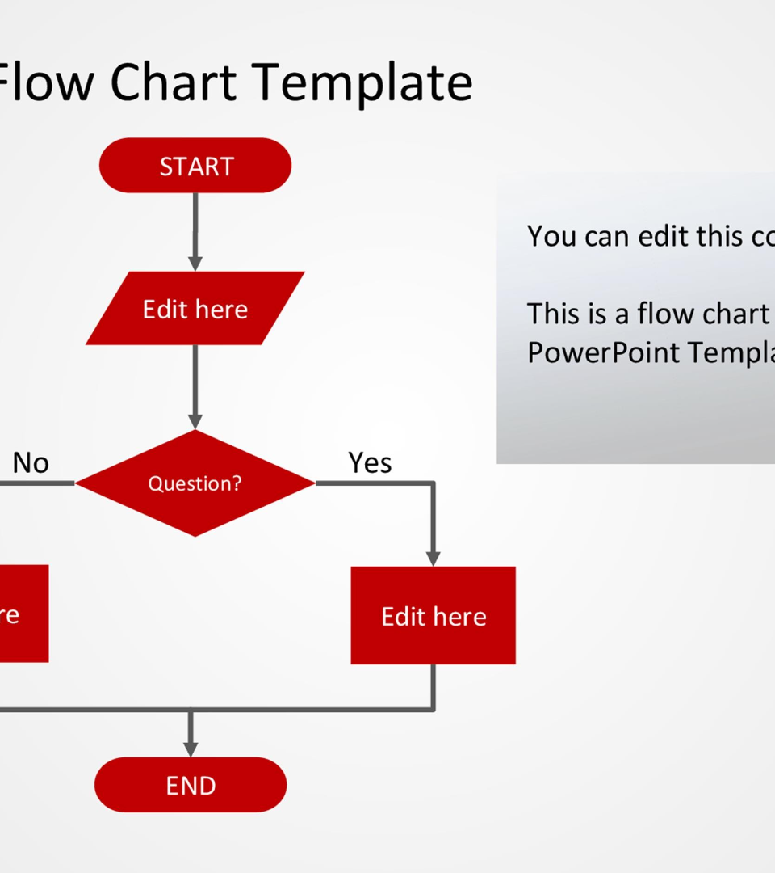
Flow Chart Interface
Visualize the workflow of the digital library management system through an intuitive and user-friendly interface, allowing efficient navigation and access to resources.

Slide 5
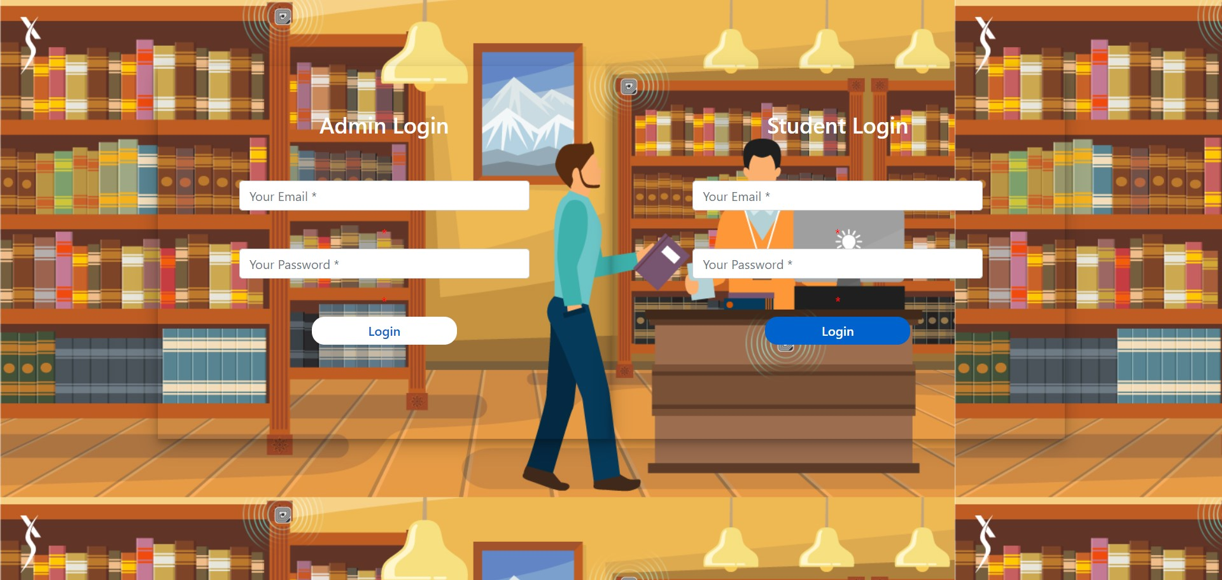
Admin and Student SignupPage

Slide 6

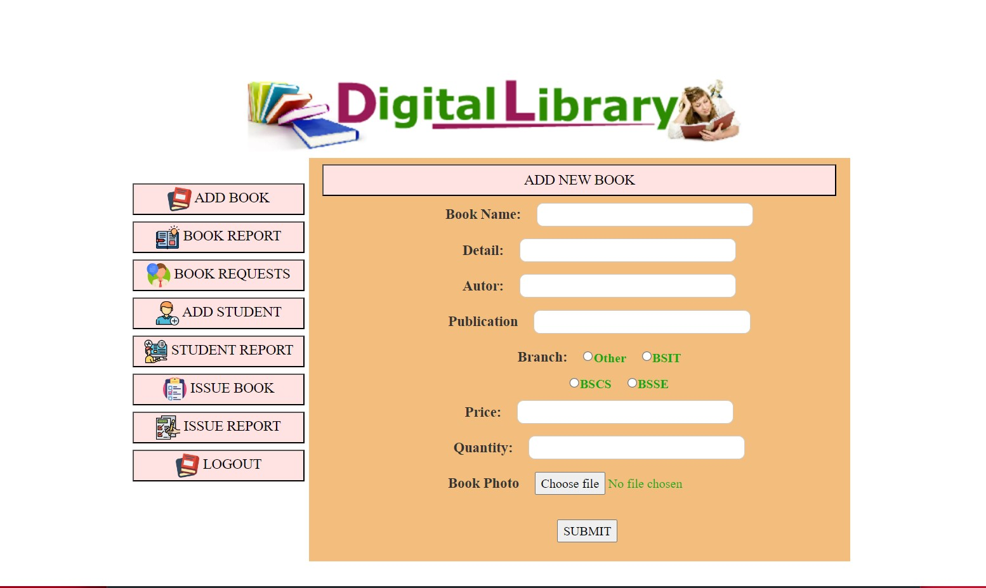
Admin Dashboard
Gain insights into the comprehensive admin dashboard, empowering administrators with powerful book management tools, user management features, and insightful analytics.

Slide 7
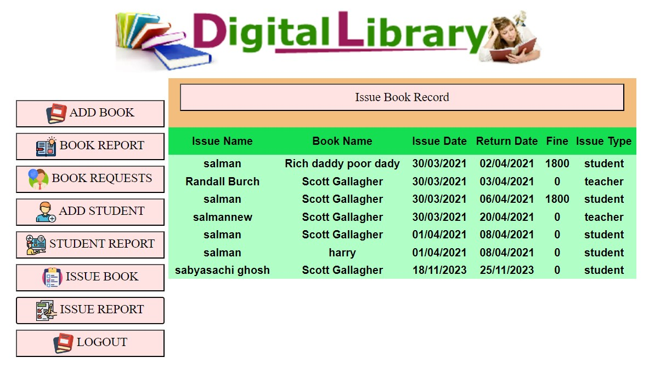
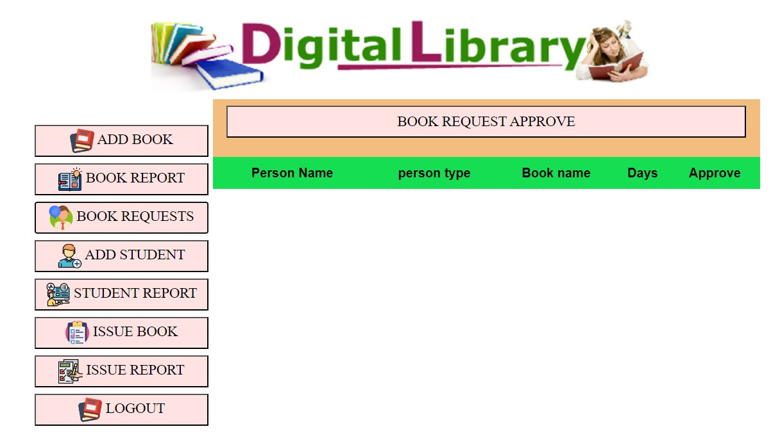
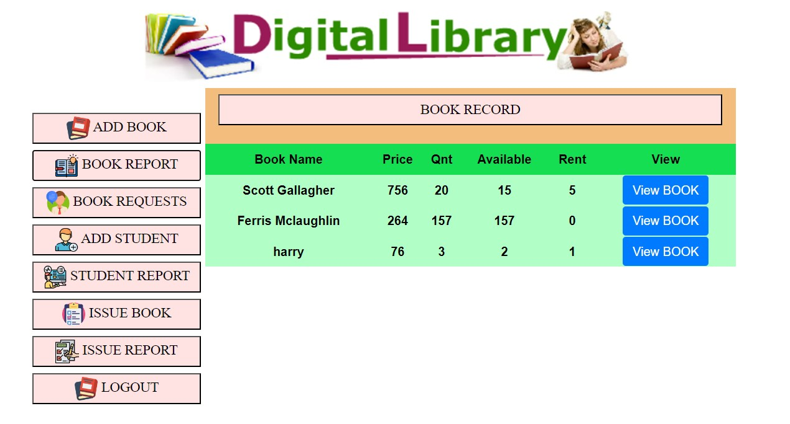
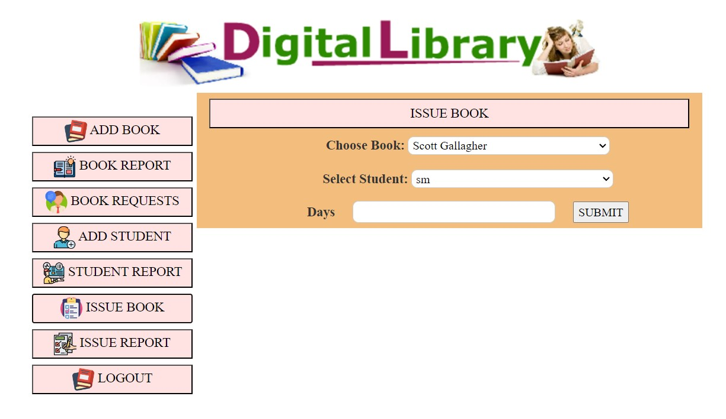
ADMIN PORTALS
ISSUE BOOK RECORD
BOOK REQUEST APPROVE
BOOK RECORD
ISSUE BOOK

Slide 8
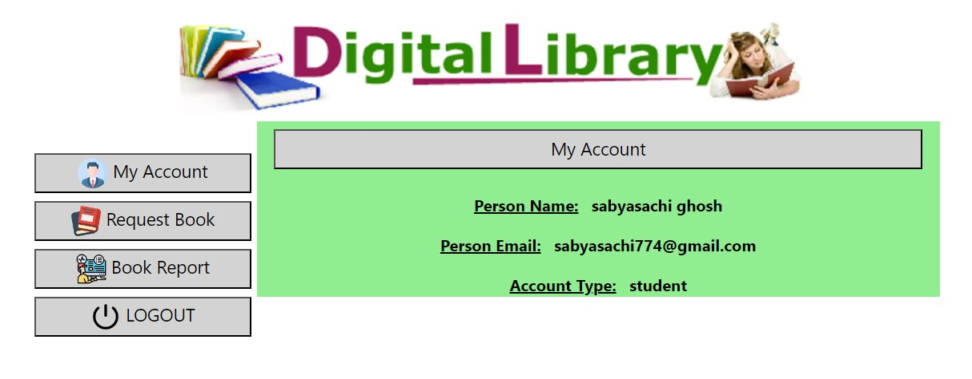
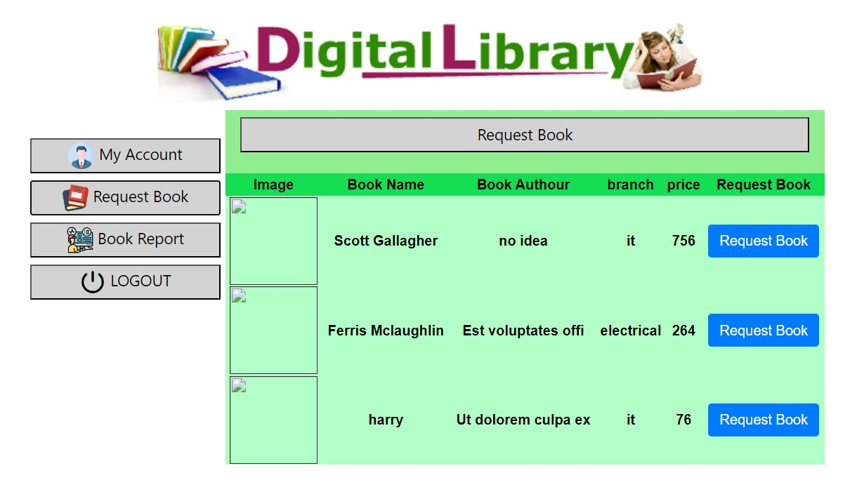
STUDENT PORTAL
MY ACCOUNT
REQUEST BOOK

Slide 9
Database
These are the queries used for creating tables in SQL
1
Admin
2
Book
CREATE TABLE book ( id int(11) NOT NULL, bookpic varchar(25) NOT NULL, bookname varchar(25) NOT NULL, bookdetail varchar(110) NOT NULL, bookaudor varchar(25) NOT NULL, bookpub varchar(25) NOT NULL, branch varchar(110) NOT NULL, bookprice varchar(25) NOT NULL, bookquantity varchar(25) NOT NULL, bookava int(11) NOT NULL, bookrent int(11) NOT NULL )
CREATE TABLE admin ( id int(11) NOT NULL, email varchar(25) NOT NULL, pass varchar(25) NOT NULL )
3
Request Books
4
Issue Book
CREATE TABLE issuebook ( id int(11) NOT NULL, userid int(11) NOT NULL, issuename varchar(25) NOT NULL, issuebook varchar(25) NOT NULL, issuetype varchar(25) NOT NULL, issuedays int(11) NOT NULL, issuedate varchar(25) NOT NULL, issuereturn varchar(25) NOT NULL, fine int(11) NOT NULL )
CREATE TABLE book ( id int(11) NOT NULL, bookpic varchar(25) NOT NULL, bookname varchar(25) NOT NULL, bookdetail varchar(110) NOT NULL, bookaudor varchar(25) NOT NULL, bookpub varchar(25) NOT NULL, branch varchar(110) NOT NULL, bookprice varchar(25) NOT NULL, bookquantity varchar(25) NOT NULL, bookava int(11) NOT NULL, bookrent int(11) NOT NULL )
5
User Data
CREATE TABLE userdata ( id int(11) NOT NULL, name varchar(25) NOT NULL, email varchar(25) NOT NULL, pass varchar(25) NOT NULL, type varchar(25) NOT NULL )

Slide 10

Conclusion
Reflect on the journey through the digital library management system and understand the potential impact it can have on knowledge sharing, accessibility, and the user experience.

Slide 11

Thank You!
Thank you for joining us on this exploration of digital library management. Feel free to reach out with any questions or feedback!

